Slide 1

What is an Inquiry Question?
It’s a question that inspires curiosity and allows you to investigate and respond visually.
Your inquiry will drive both your research and art-making processes.
It should connect with your experience and reflections from the Immersive Excursion to South Stradbroke Island
Introduction to Developing Your Inquiry Question
In this unit, you will develop an inquiry question that guides your visual investigation. This question should be open-ended and allow for deep exploration of a concept or theme through your artwork. It will also shape the focus of your body of work and allow you to engage with different contexts—personal, cultural, contemporary, and formal.

Slide 2
Reflect on the Stimulus
Consider your reaction to the Immersive Excursion stimulus and how it connects to your personal interests, experiences, or world events.
Think about the ideas, concepts, or philosophies that resonate with you.
Ask Yourself Questions
What aspects of the stimulus provoke a strong emotional or intellectual response?
What ideas do you want to explore in more depth through your artwork?
Formulate Your Inquiry
Your inquiry question should be broad enough to allow for exploration but specific enough to guide your decisions.

Slide 3
A powerful question:
generates curiosity
stimulates reflective conversation
is thought provoking
surfaces underlying assumptions
invites creativity and new possibilities
generates energy and movement forward from unknown to known
channels attention and focuses inquiry
evokes more questions
Ask yourself
Is the question relevant?
Is it a genuine question – a question to which I/we really don’t know the answer?
What do I want this question to do? That is what kind of conversation, meanings and feelings do I imagine this question will evoke in those who will be exploring it and as audience?
Is this question likely to invite fresh thinking / feeling? Is it familiar enough to be recognizable and relevant – and different enough to call for a different response?
What assumptions and/or beliefs are embedded in the way the question is constructed?
Is the question likely to generate hope, imagination, engagement, creative action and new possibilities?
Does this question leave room for new and different questions to be raised as the initial question is explored?
DO’s DON’T’s
Curiosity Boredom
Reflection Reaction
Reveals assumptions Extends biases or prejudice
Creativity Agreement
Energy Stall
Engagement Distraction
Meaningful Trivial
Trigger more questions Dead-ends

Slide 4
Example Questions:
How can I visually explore the influence of technology on cultural identity?
How do personal memories shape our perception of truth?
What role does art play in critiquing social norms?
How does culture influence the human experience?
How does science contribute to an artistic examination of change ( example change in the environment )?
How do artists communicate or provoke ideas about social change and human behaviour?
How do histories, legacies and stories contribute to an artists’ practise?
How do artists challenge social trends by provoking ideas about the impact of change
( example – impact of new technology )?
How does the evidence left by a person communicate an understanding of the individual?
How do artists raise ethical issues in artworks?
What is the overlap between art, technology, psychology, imagination and reality?
Art as Lens: Consider the values that underpin or influence the way subject matter ( people, place, object ) is perceived and represented.
Art as Code: Explore how visual language, symbol systems and art conventions can express ideas and feelings in images, objects and experiences.

Slide 5
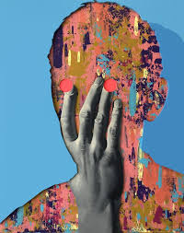
Once you’ve developed your inquiry question, you’ll need to select mentor artists whose work informs your creative decision-making. These artists will guide your process, offering inspiration and techniques that relate to your inquiry.
Why Mentor Artists?
Their practices will provide you with insights into how to respond to your question visually.
You can experiment with their techniques, media, and ideas to develop your own visual language.
Selecting Mentor Artists:
Look for artists who explore similar themes, contexts, or questions.
Choose two or more artists who can offer contrasting or complementary perspectives.

Slide 6
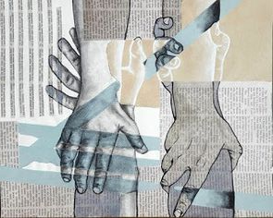
Formal Context: Focus on the visual elements—composition, colour, line, form—and how they communicate meaning in your artwork.
Your inquiry and your artwork must address the Formal Context plus at least one of the other 3 contexts.
Personal Context: Reflect on your own experiences, identity, and emotions. How do they shape the way you see the world?
Cultural Context: Consider how cultural traditions, histories, and social structures influence your perspective.
Contemporary Context: Engage with current issues, such as politics, technology, or social justice, and how they affect society.

Slide 7

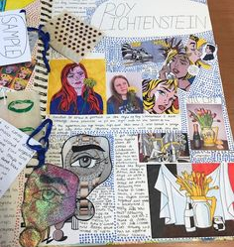
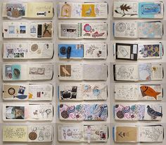
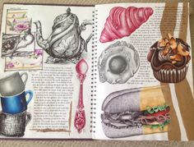
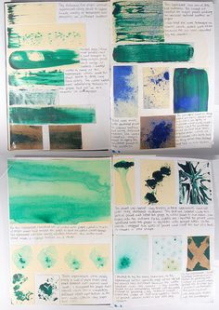
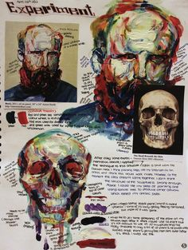
Once your inquiry question is developed, use it to guide your experimentation with materials, techniques, and processes.
Steps for Experimentation
Research: Investigate your mentor artists’ techniques and how they relate to your question.
Test Materials: Experiment with different media (painting, sculpture, digital) to see how they can express your inquiry visually.
Reflect: Continuously evaluate how your experiments respond to your inquiry. Adjust your approach as needed.

Slide 8
Your final presentation should communicate
Your Inquiry Question: What inspired it? How did you develop it?
Key Artists: Analyse and interpret the work of your mentor artists. How do they influence your own visual responses?
Conclusions: What have you discovered through your research and experimentation? How will this inform your body of work?
Your presentation can be in the form of:
A written report (1000-1500 words)
A multimodal presentation (7-9 minutes)
A digital presentation (8-10 slides or equivalent media)

Slide 9

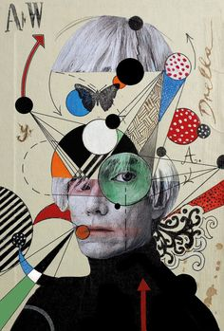
Consultation: Meet with your teacher to discuss your inquiry question.
Experimentation: Begin testing materials and processes.
Draft Submission: Submit your draft for feedback to refine your approach.
This is the start of your visual journey—your inquiry question will guide your exploration, and your selected mentor artists will inspire and inform your creative practice. Let your curiosity drive your work!

